Slide 1

WELCOME TO
WATERLOO REGION

Slide 2



Hosts
Arlan Nugara
WRAG meetup organizer
Ken Cenerelli
WRAG meetup co-organizer
@WRAGmeetup #WRAGmeetup #GlobalAzure

Slide 3

Presented By
Waterloo Region Azure Group Meetup
Launched February 2018
47 members so far
Register:
http://bit.ly/wrag
Social Media:
@WRAGmeetup (twitter.com/WRAGmeetup)
#WRAGmeetup
@WRAGmeetup #WRAGmeetup #GlobalAzure

Slide 4








Sponsors
@WRAGmeetup #WRAGmeetup #GlobalAzure

Slide 5
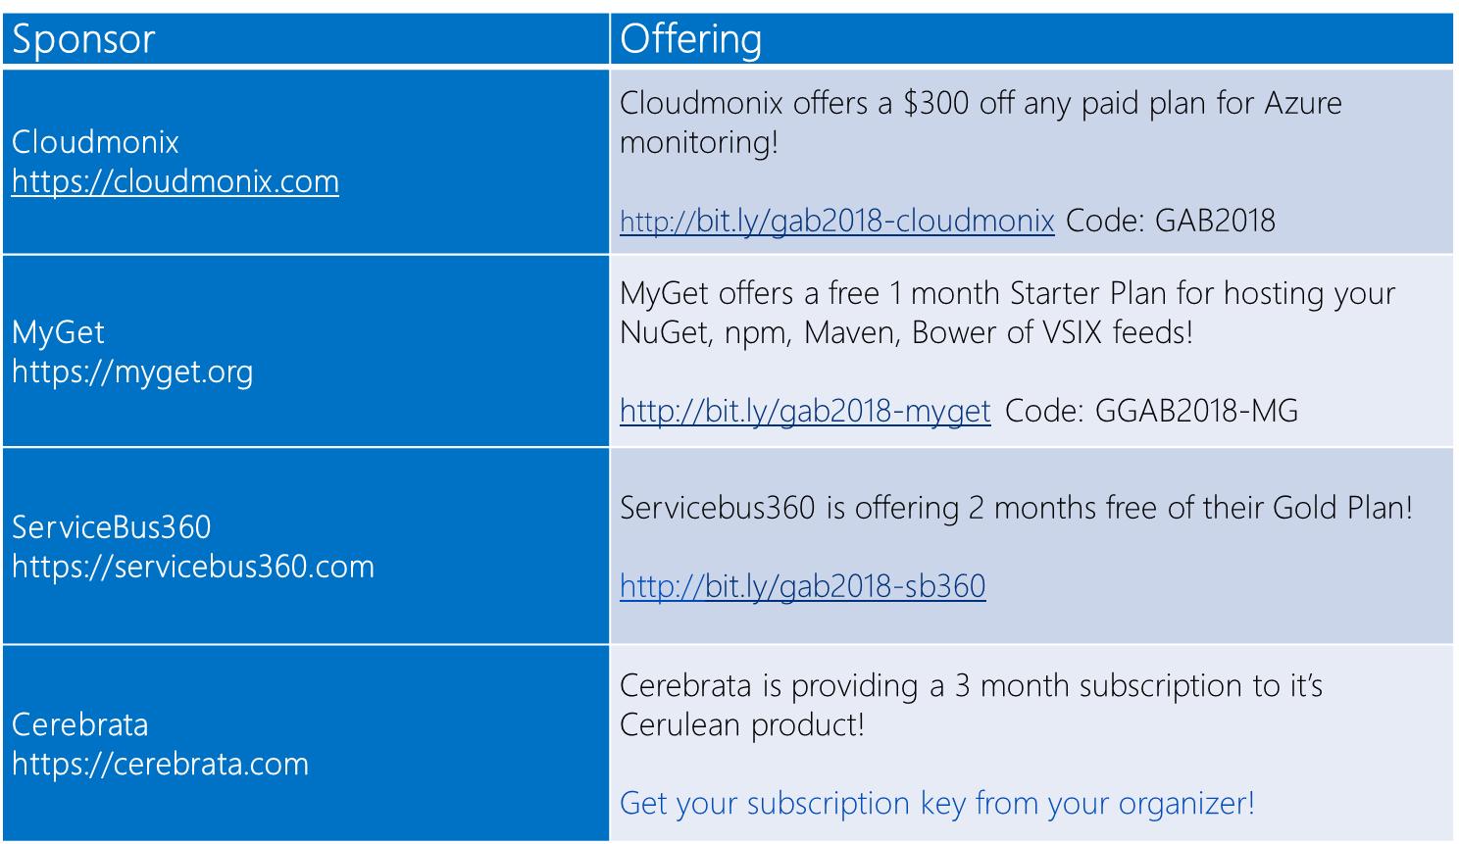


All attendees get the following:
SWAG
* Offers valid until April 30th
@WRAGmeetup #WRAGmeetup #GlobalAzure

Slide 6


Raffle Prizes
1 Winner: a 1 year personal subscription of the All Products Pack. Get all desktop products including IntelliJ IDEA Ultimate, ReSharper Ultimate and other IDEs
1 Winner: a 1 year subscription to Cerulean! A cross-platform Azure management tool for storage, CosmosDB, Search, Redis Cache and Service Bus.
1 Winner: a 1 year subscription to their online training, Skill Me Up! Online training to continue your Azure journey.
@WRAGmeetup #WRAGmeetup #GlobalAzure

Slide 7
FREE LinkedIn Learning Courses
Azure Development Essential Training: 1 Azure Roadmap and Key Features
Microsoft Azure; Architecting Azure Infrastructure
Planning a Microsoft Cloud Solution
Microsoft Azure: Implement Azure Active Directory
Microsoft Azure: Design Azure Web and mobile Apps
Azure Development Essential Training: 2 Working with Data
Microservices and Azure Service Fabric Basics for Developers
Azure Search for Developers
Azure DevTest Labs Quick Start
Microsoft Azure Stack First Look
Microsoft Azure: Virtual Network Implementation
Microsoft Cybersecurity Stack: Identity and endpoint Protection Basics
Microsoft Azure: Design Advanced Applications
Microsoft Azure: Design and Implement a Storage Strategy
Microsoft Azure: Design and Implement App Service Apps
Microsoft Azure: Design and Deploy ARM Templates

Slide 8

Upcoming Event
Global DevOps Bootcamp – Waterloo Region
Saturday, June 16, 2018
Location: TBD
More information: http://bit.ly/wrag
@WRAGmeetup #WRAGmeetup #GlobalAzure

Slide 9
Shout Out
Canada's Technology Triangle .NET User Group
Celebrating 15 years in 2017-2018
735 members
Register:
meetup.com/CTTDNUG
Social Media:
@CTTDNUG (twitter.com/CTTDNUG)
#CTTDNUG
@WRAGmeetup #WRAGmeetup #GlobalAzure

Slide 10


June 22nd – 8am to 5pm
Microsoft Canada Headquarters, 1950 Meadowvale Blvd. Mississauga, ON
https://powerofthecloud.net
Peer-to-peer education workshop led by MVPs and Industry Experts
Business Process Automation – Flow, PowerApps and PowerBI
Collaboration & Content Management – SharePoint, Office 365 Groups and Teams
Introduction to the Azure Cloud – Accelerate you journey to the Azure cloud
Hands-on step-by-step workshop
Notes:
In each track, you will be taken through a journey on how the services work with presentations & live demos.
In the last session of the day, each attendee will be given the opportunity to be in a hands-on step-by-step facilitated workshop which will guide them through actually using the services they learned throughout the day to implement a simple business solution.

Slide 11
Agenda
09:15-09:25 Intro + Housekeeping
09:30-10:20 DevTest Labs
10:30-11:20 Adv. Azure Web Apps
11:30-12:20 CD for Azure Web Apps
12:30-13:30 Lunch + Networking
13:30-14:20 App Service Environments
14:30-15:20 Azure Event Grid
15:30-16:00 AMA/Q&A
16:00 Close Out/Prizes
@WRAGmeetup #WRAGmeetup #GlobalAzure
Notes:
9:00 Doors Open/Networking
9:15 – 9:25 Introduction and Housekeeping
9:30 – 10:20 Speaker #1 Sharon Bennett: DevTest Labs
10:30 – 11:20 Speaker #2 Roy Kim: Advanced techniques for Azure Web Apps
11:30 – 12:20 Speaker #3 Rob Prouse: Continuous delivery for Azure Web Apps
12:30 – 1:30 Lunch/Networking
1:30 – 2:20 Speaker #4 David Christensen & Zach Koncir: App Service Environments (ASEs) in highly compliant scenarios
2:30 – 3:20 Speaker #5 Callon Campbell: Azure Event Grid
3:30 – 4:00 AMA/Q&A + Close Out/Prizes
4:15 End

Slide 12
Introduction To Azure

Slide 13


Slide 14
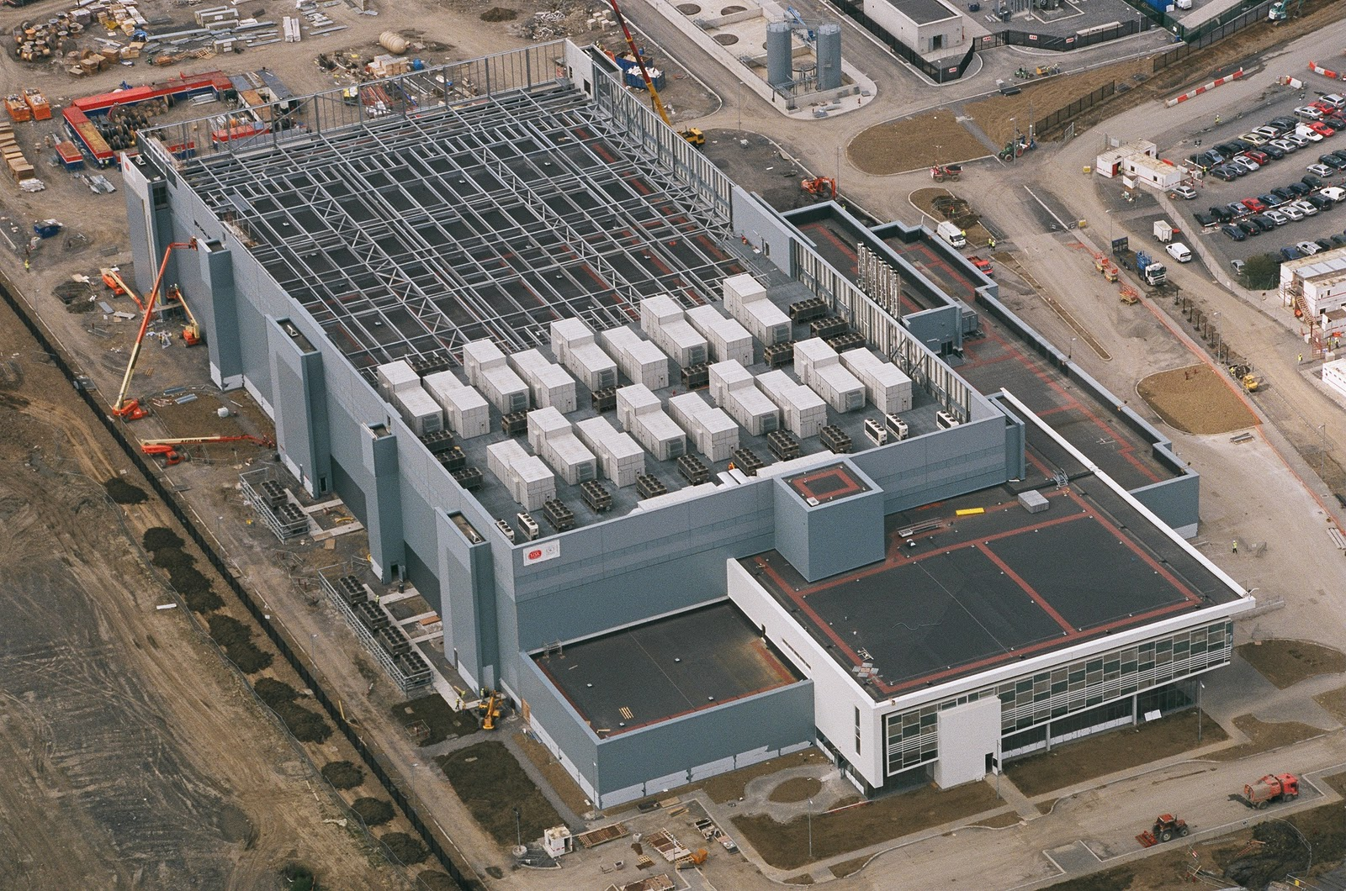
Notes:
This is what we think of when we hear the word “Datacenter”

Slide 15
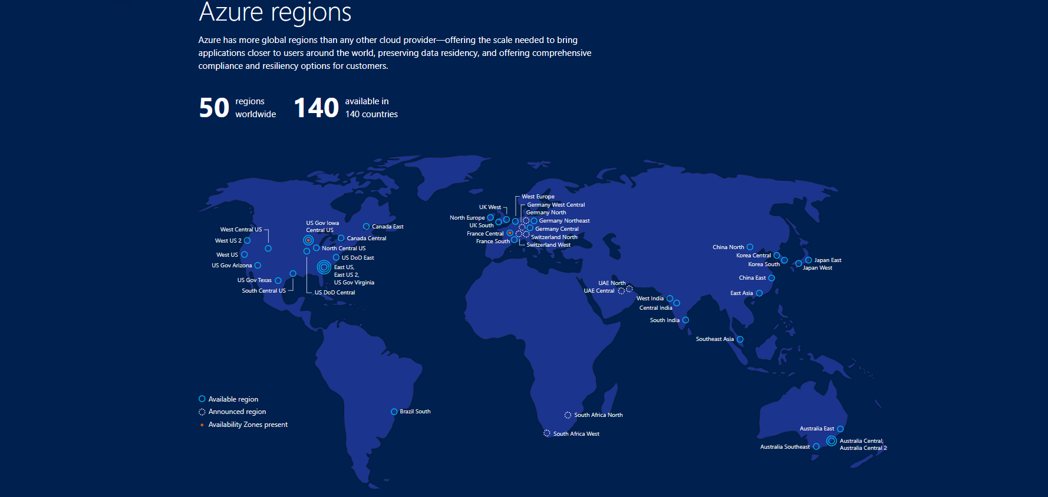
Achieve global scale, in local regions
Notes:
Availability Zones is a high-availability offering that protects your applications and data from datacenter failures. Availability Zones are unique physical locations within an Azure region. Each zone is made up of one or more datacenters equipped with independent power, cooling, and networking. To ensure resiliency, there’s a minimum of three separate zones in all enabled regions. The physical separation of Availability Zones within a region protects applications and data from datacenter failures.

Slide 16
So why Azure?

Slide 17
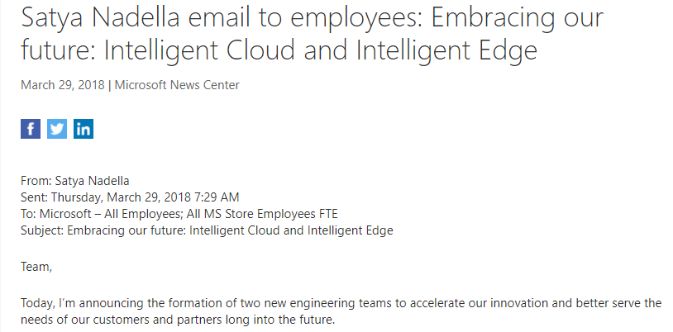
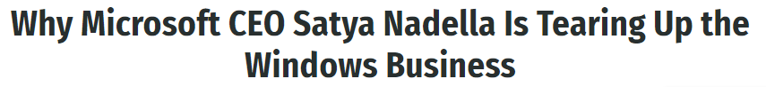
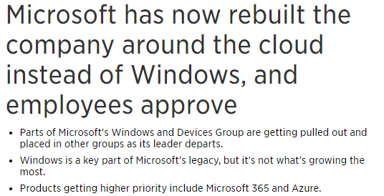
It’s Microsoft chief focus

Slide 18
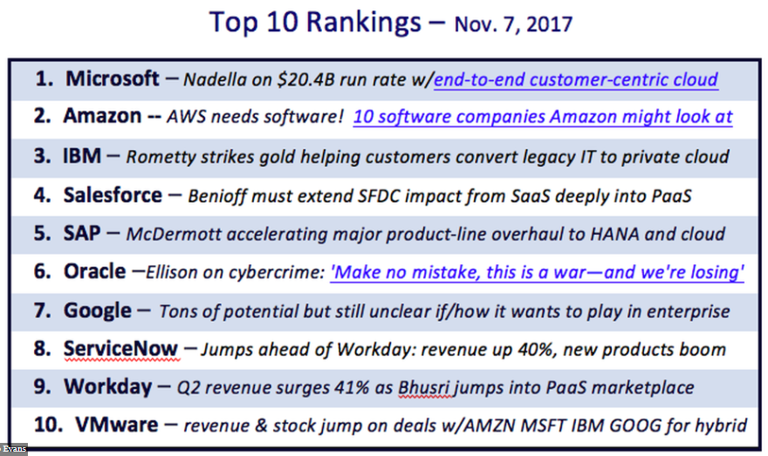
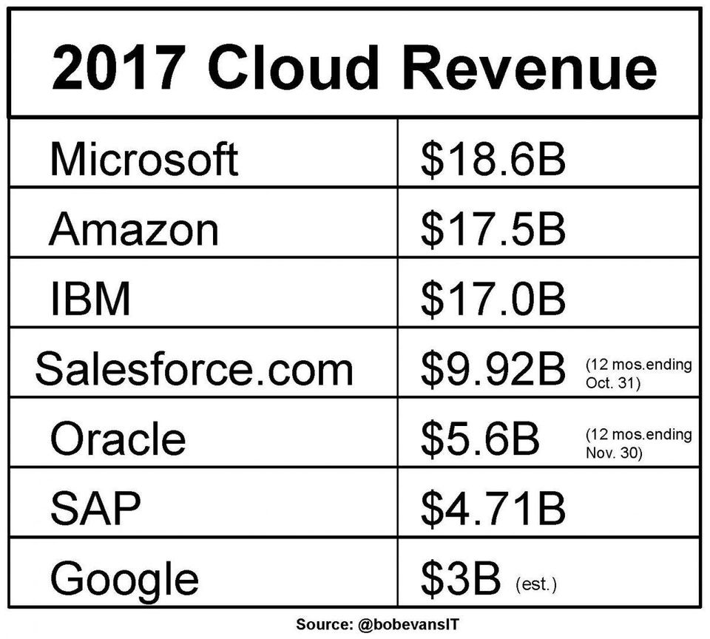
It’s a powerhouse!

Slide 19

Notes:
Azure isn’t about Windows, its about enabling you to achieve more. Microsoft is undergoing a tremendous transformation and Linux/ Open Source Software is part of it. In a second we will dive in and I want you to remember that Microsoft is now the number contributor to OSS on GitHub and that some of the offered services are built and operated on Linux.
One of these services is the Azure SDN (Software Defined Network)
http://www.datacenterdynamics.com/content-tracks/servers-storage/microsoft-runs-azure-networking-on-linux/94837.fullarticle
Azure cloud uses Linux to handle data center networking - in a specialized software component developed by Microsoft to run connectivity within its cloud operating system, along lines set out by the Open Compute Project.

Slide 20
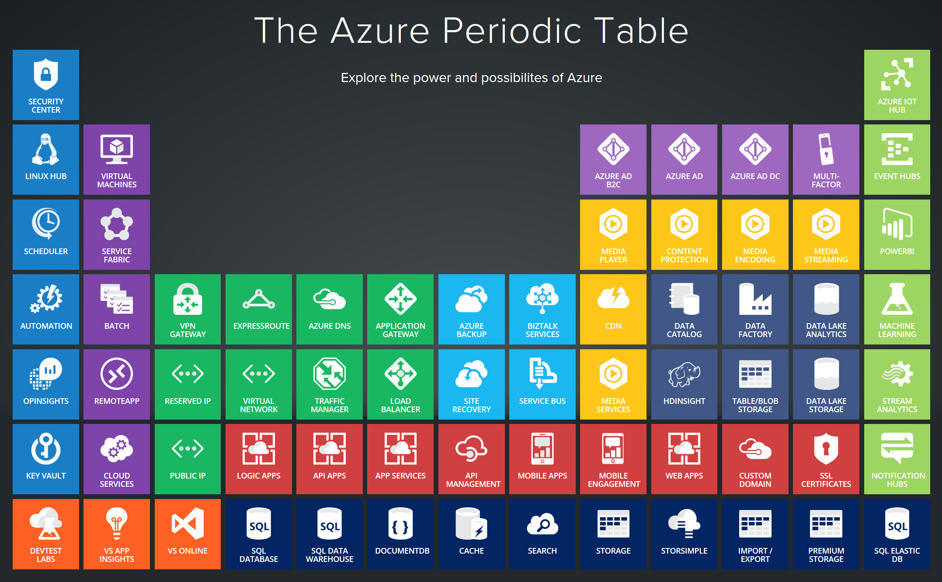
Notes:
Azure services support a multitude of scenarios from Infrastructure to platform services and extends your existing environments through various interconnectivity options. In today’s world, the level of sophistication required to innovate and compete requires us to be agile and adjust to a rapidly changing landscape. The cloud-only approach doesn’t work well for every scenario. Think about IoT and business critical workloads that drive delay sensitive manufacturing processes. Success comes from taking a hybrid approach and leveraging the cloud where it makes sense.

Slide 21
http://portal.azure.com
Notes:
Walk through the different sections, support tickets, azure market place, resource groups….

Slide 22
References:
Get started with Azure
Microsoft Azure Blog
Azure Updates
Cloud Platform roadmap
Azure Code Samples
Azure Quickstart Templates
AzureCAT Guidance
Cloud Design Patterns

